Slide 1
Advanced Computer Graphics
Geometric Modeling- Project Presentation
Group 1 - Okulmus, Spiss, Mildenberger

Slide 2
Technical Overview
Procedural Plants (Okulmus)
Terrain Generation (Spiss, Mildenberger)

Slide 3
Procedural Plants
Based on L-Systems, from Aristid Lindenmayer (in 1968)
Idea: Plantlife growth is based on simple reoccuring rules
A formal grammar that defines “production rules”
w: a
r1: a -> ab
r2: b -> a
w: A
r1: A -> C+[A+G]--//[--E]C[++E]-[AG]++AG
r2: C -> FD[//&&E][//^^E]
r3: C -> C
r4: D -> DFD
r5: D -> D
r6: D -> D[//&&E][//^^E]FD
r7: E -> ['{+f-ff-f+|+f-ff-f}]
r8: G -> [&&&H'/B////B////B////B////B]
r9: H -> FF
r10: B -> ['^F][{&&&&-f+f|-f+f}]

Slide 4
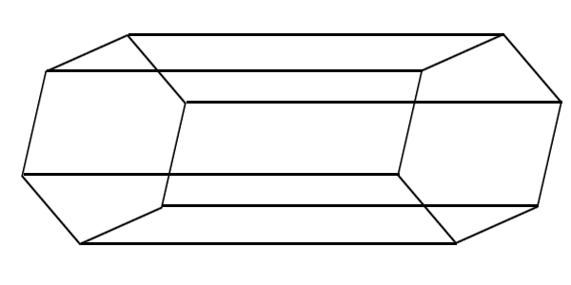
3D Turtle Graphics
Renders a given L-System string to a 3D mesh
Needs a simple interpretation of symbols to
Move forward
Orientate in space (yaw,pitch,roll)
Start a branch (push/pop state to/from stack)
Change other state propreties (line radius, color, etc.)
3D lines are generated by combining to hexagons

Slide 5
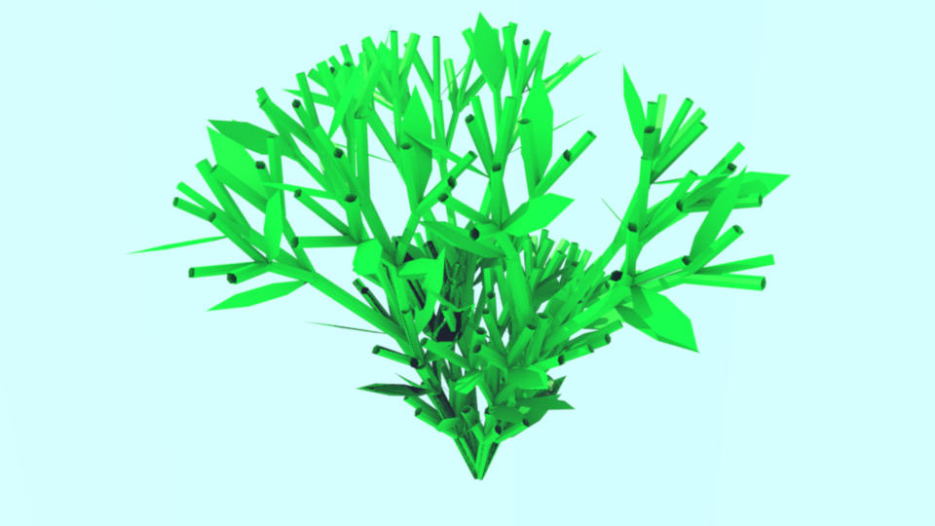
Results Procedural plants

Slide 6
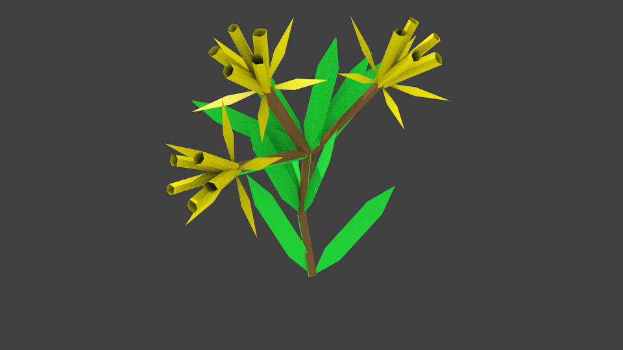
Results Procedural plants

Slide 7
Terrain Generation

